Slide 1
Length Of Stay Prediction

Slide 2

Predicting hospital length-of-stay at time of admission
https://towardsdatascience.com/predicting-hospital-length-of-stay-at-time-of-admission-55dfdfe69598
https://github.com/daniel-codes/hospital-los-predictor
https://github.com/daniel-codes/hospital-los-predictor/blob/master/hospital_los_prediction.ipynb

Slide 3
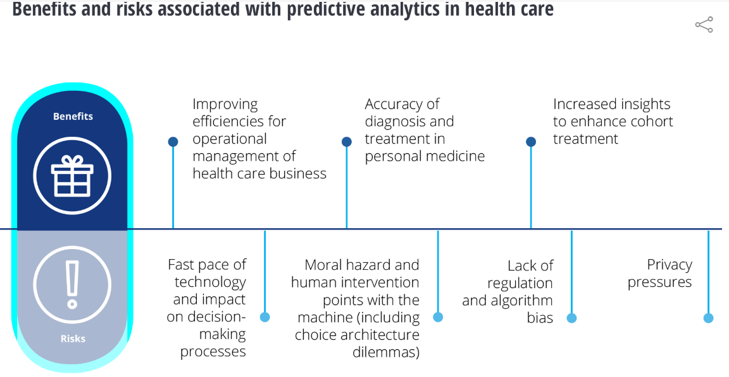
Predictive Analytics for Healthcare
Predictive analytics is an increasingly important tool in the healthcare field since modern machine learning (ML) methods can use large amounts of available data to predict individual outcomes for patients.
https://www2.deloitte.com/us/en/insights/topics/analytics/predictive-analytics-health-care-value-risks.html

Slide 4
LOS
hospital length-of-stay (LOS)
LOS is defined as the time between hospital admission and discharge measured in days.
U.S. hospital stays cost the health system at least $377.5 billion per year and recent Medicare legislation standardizes payments for procedures performed, regardless of the number of days a patient spends in the hospital. This incentivizes hospitals to identify patients of high LOS risk at the time of admission. Once identified, patients with high LOS risk can have their treatment plan optimized to minimize LOS and lower the chance of getting a hospital-acquired condition such as staph infection. Another benefit is that prior knowledge of LOS can aid in logistics such as room and bed allocation planning.
https://www.healthcatalyst.com/success_stories/reducing-length-of-stay-in-hospital

Slide 5
Goal
The goal is to create a model that predicts the length of stay for each patient at time of admission

Slide 6
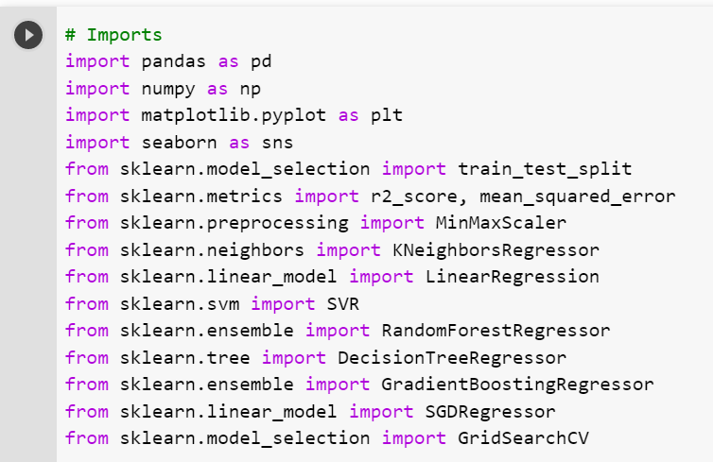
Import libraries or packages

Slide 7
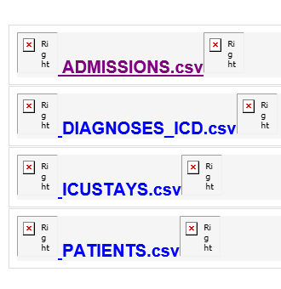
MIMIC III data
We need the following tables for this tutorial
Unzip the files and upload them to google colab

Slide 8
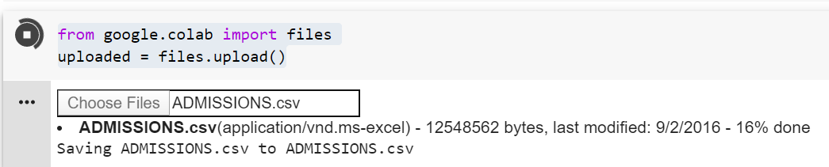
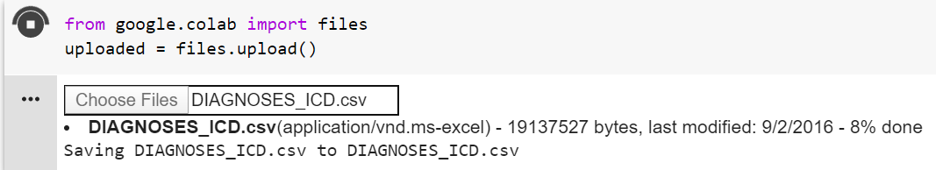
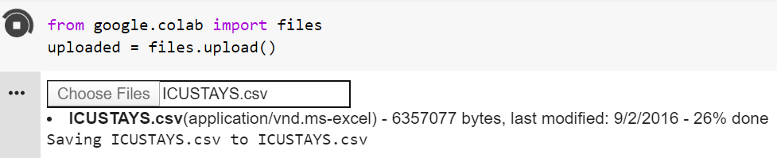
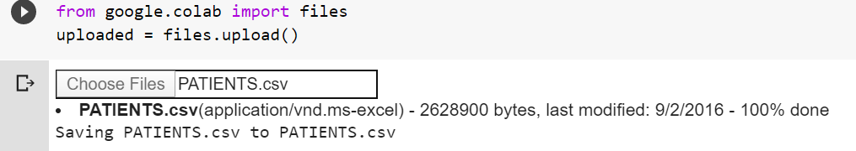
Load MIMIC tables

Slide 9
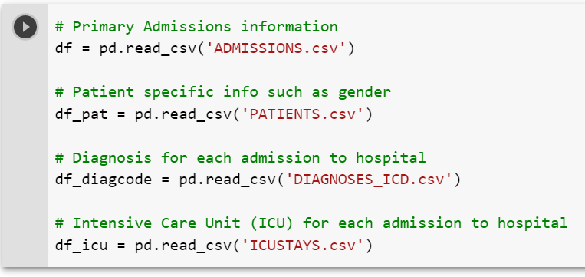
Read data into google colab

Slide 10
Data Exploration and feature engineering
From MIMIC: The ADMISSIONS table gives information regarding a patient’s admission to the hospital. Since each unique hospital visit for a patient is assigned a unique HADM_ID, the ADMISSIONS table can be considered as a definition table for HADM_ID. Information available includes timing information for admission and discharge, demographic information, the source of the admission, and so on.

Slide 11
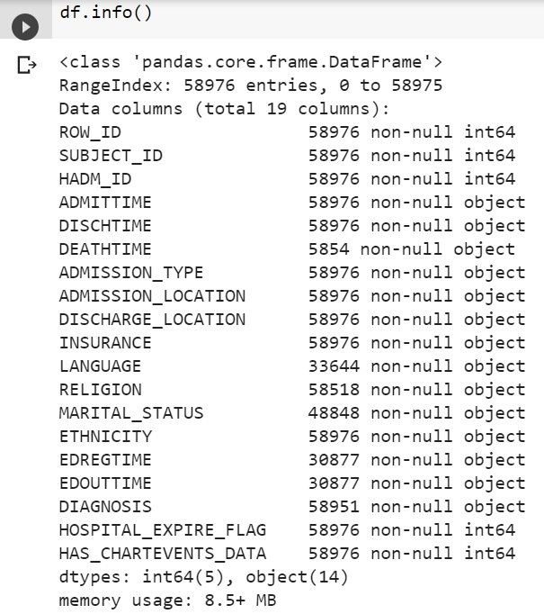
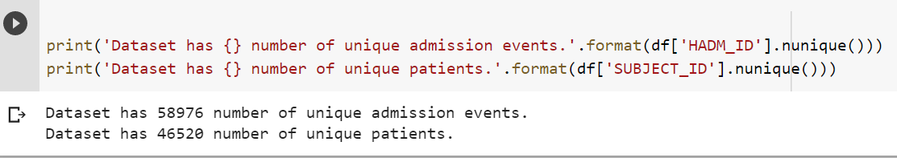
ADMISSIONS.csv Exploration

Slide 12
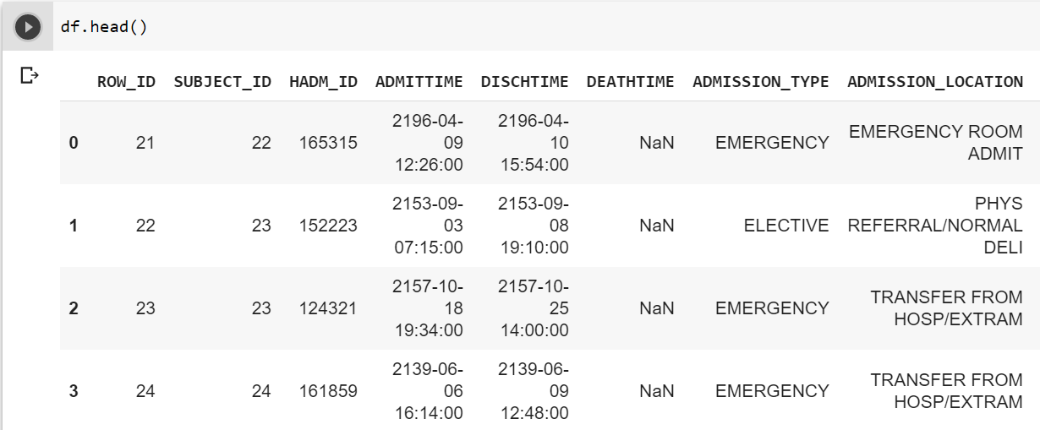
Feature Engineering
The first task is to figure out a way to calculate the LOS. LOS is defined as the time between admission and discharge from the hospital.

Slide 13
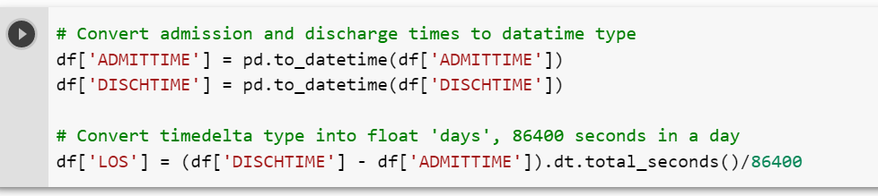
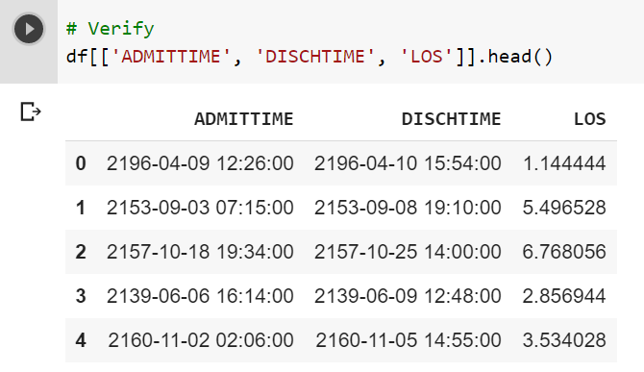
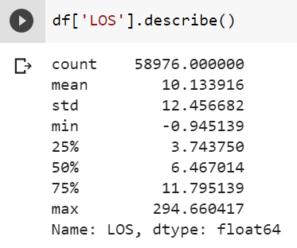

Slide 14
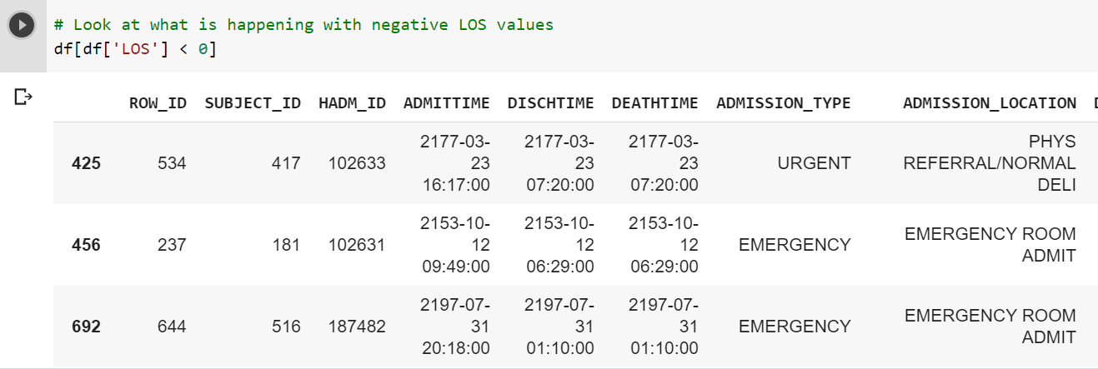
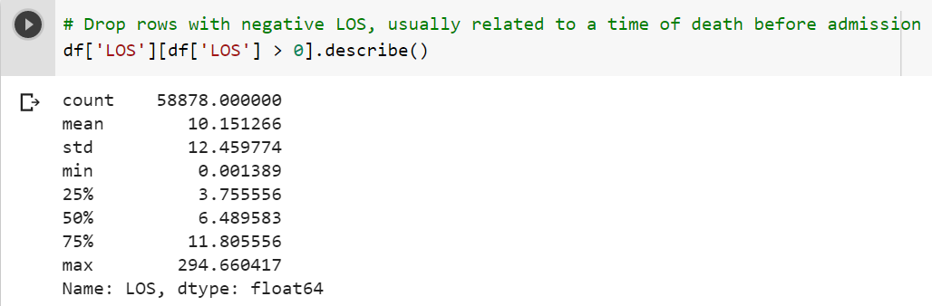

Slide 15
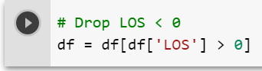
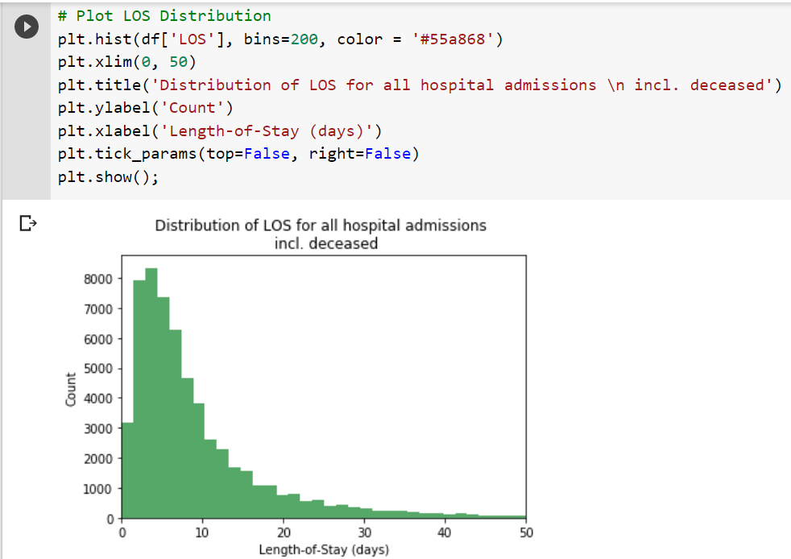

Slide 16
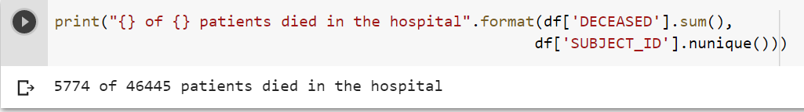
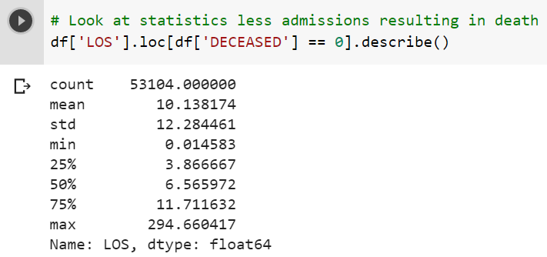
Deathtime

Slide 17
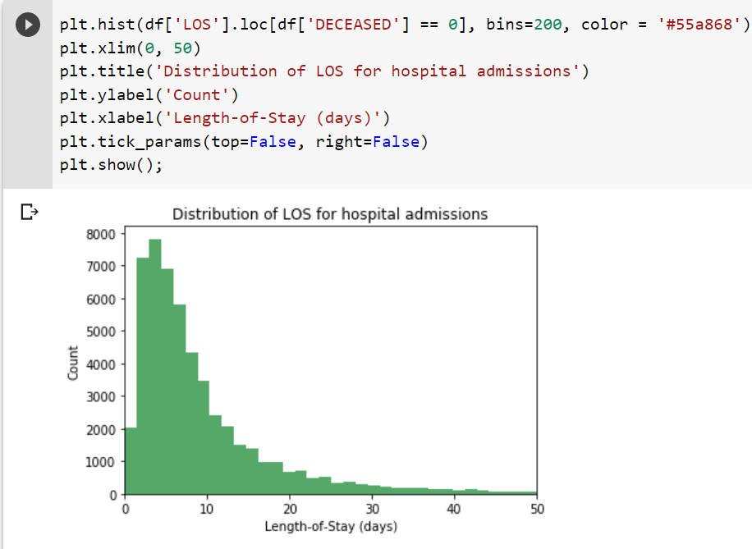
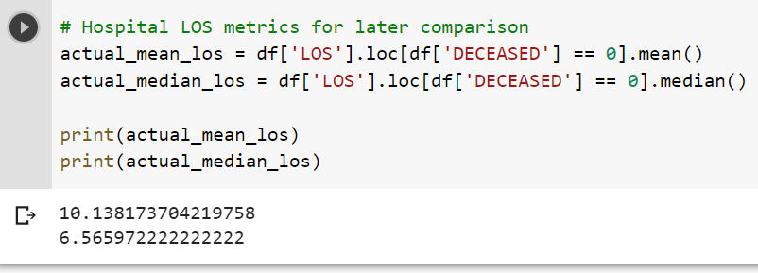

Slide 18
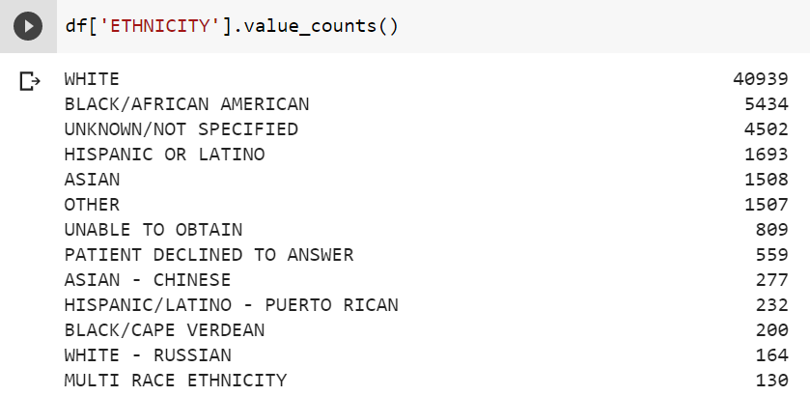
Ethnicity

Slide 19
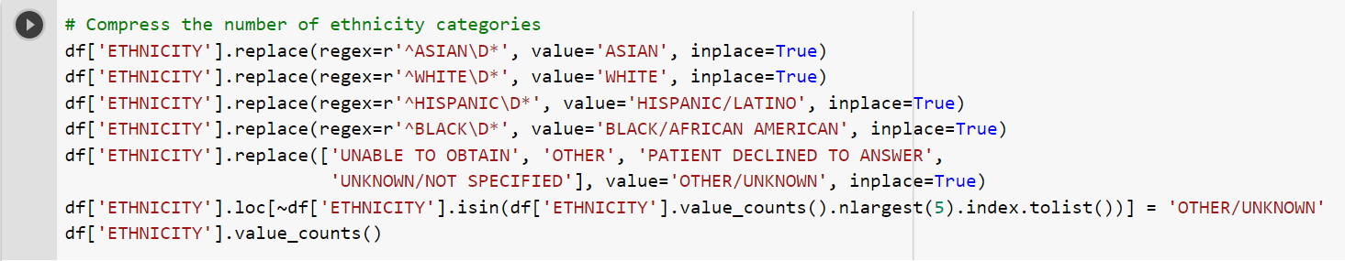
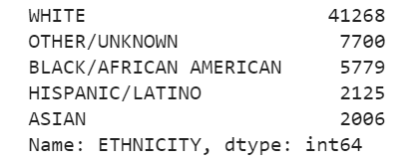

Slide 20
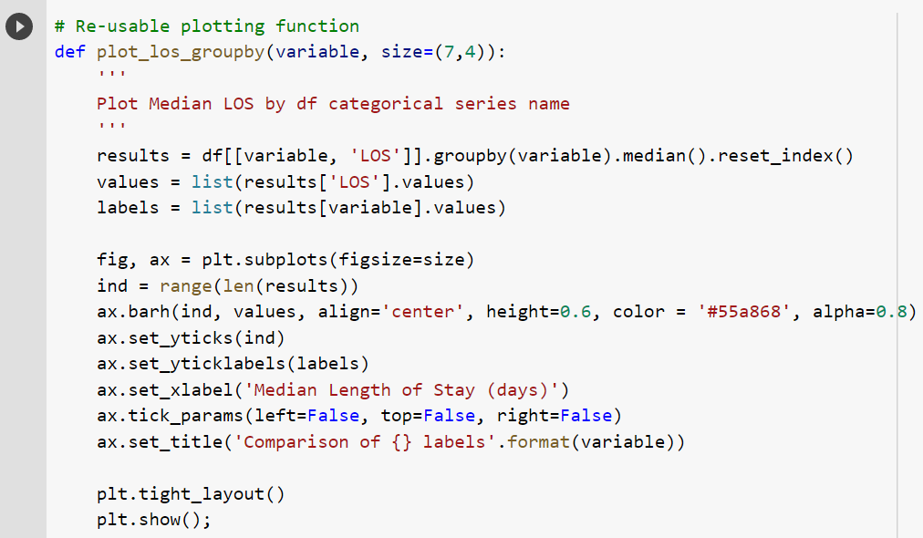
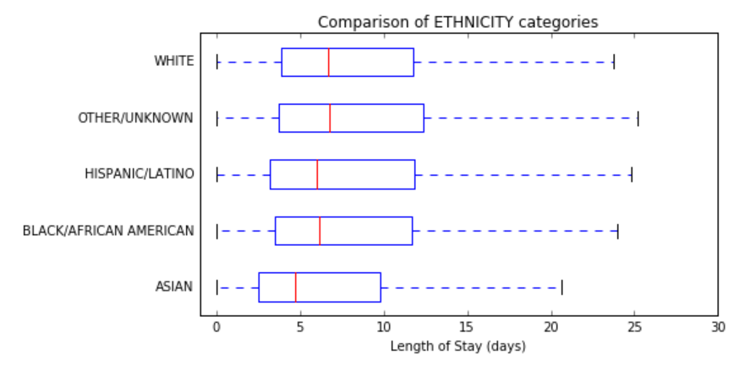

Slide 21
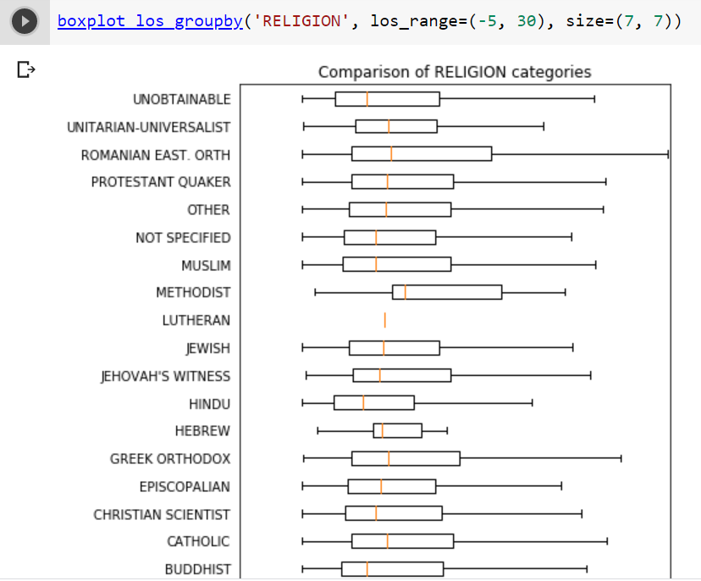
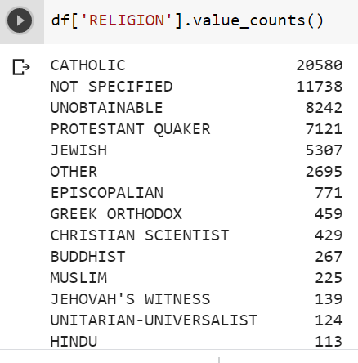
Religion

Slide 22
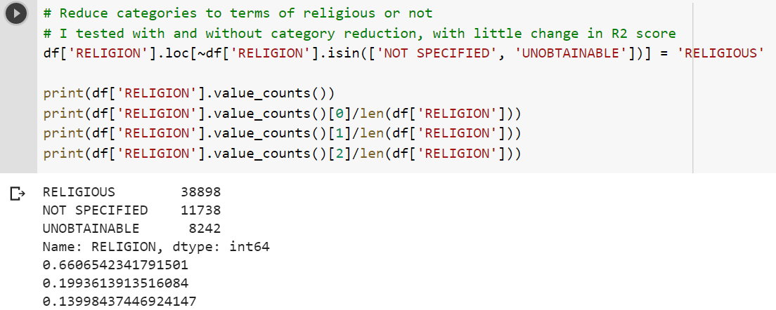
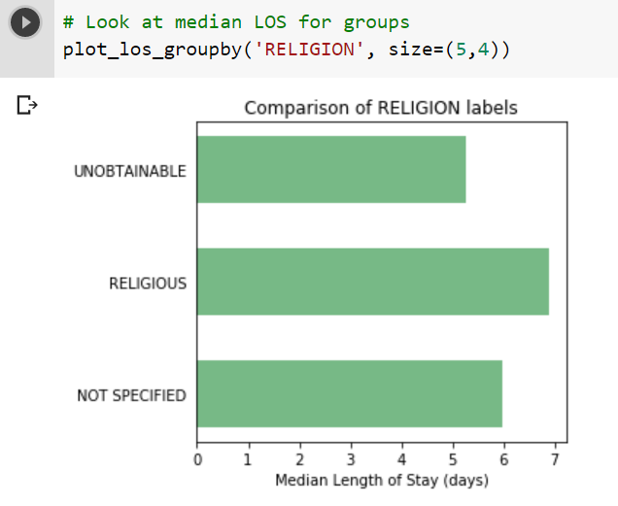

Slide 23
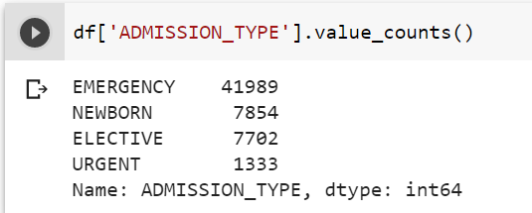
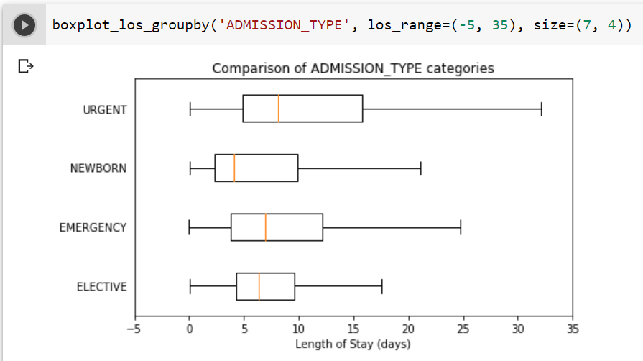
Admission type

Slide 24
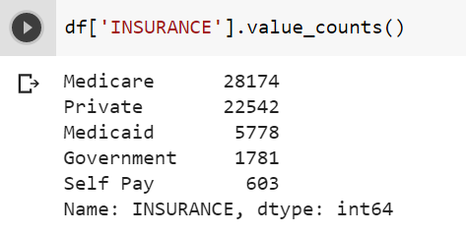
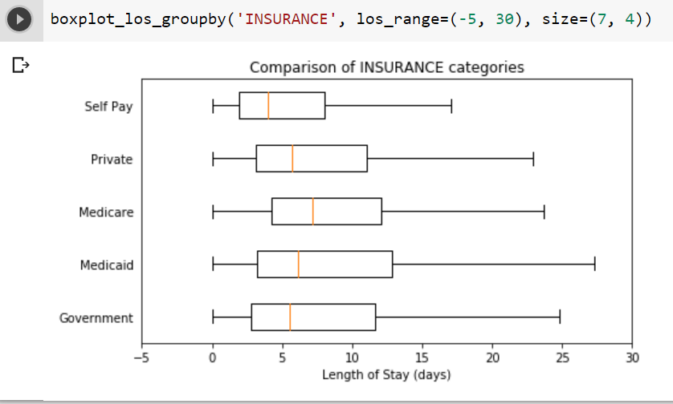
Insurance

Slide 25
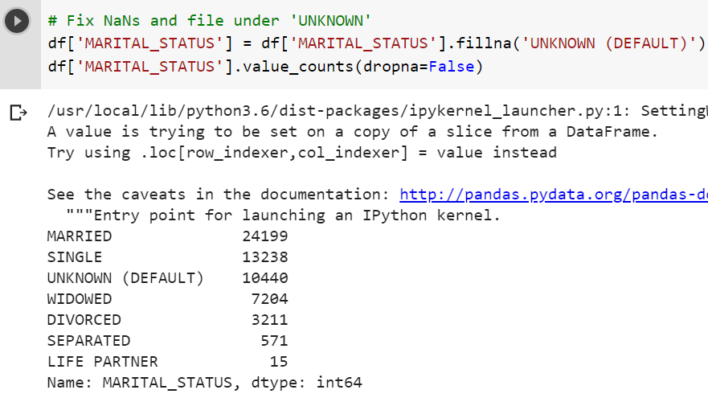
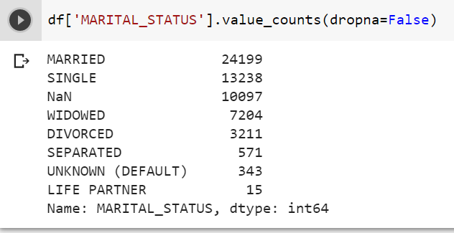
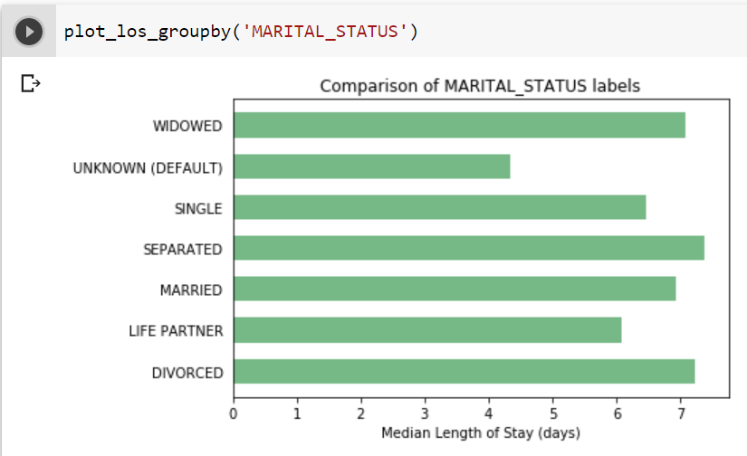
Marital Status

Slide 26
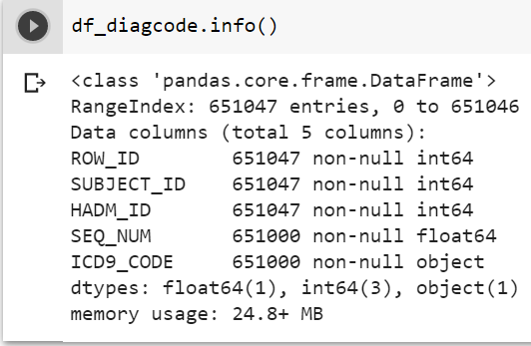
DIAGNOSES_ICD.csv Exploration
This section explore the ICUSTAYS.csv table of the MIMIC-III dataset.

Slide 27
ICD-9 Code Feature Engineering
Because it's not feasible to have 6984 unique values to use as features for predicting LOS, I need to reduce the diagnosis into more general categories. After researching the ICD9 approach, I discovery that they arranged into super categories as the following (source):
001–139: infectious and parasitic diseases
140–239: neoplasms
240–279: endocrine, nutritional and metabolic diseases, and immunity disorders
280–289: diseases of the blood and blood-forming organs
290–319: mental disorders
320–389: diseases of the nervous system and sense organs
390–459: diseases of the circulatory system
460–519: diseases of the respiratory system
520–579: diseases of the digestive system
580–629: diseases of the genitourinary system
630–679: complications of pregnancy, childbirth, and the puerperium
680–709: diseases of the skin and subcutaneous tissue
710–739: diseases of the musculoskeletal system and connective tissue
740–759: congenital anomalies
760–779: certain conditions originating in the perinatal period
780–799: symptoms, signs, and ill-defined conditions
800–999: injury and poisoning
E and V codes: external causes of injury and supplemental classification, using 999 as placeholder even though it overlaps with complications of medical care
Now the task is to re-code the in terms of these category groups.

Slide 28
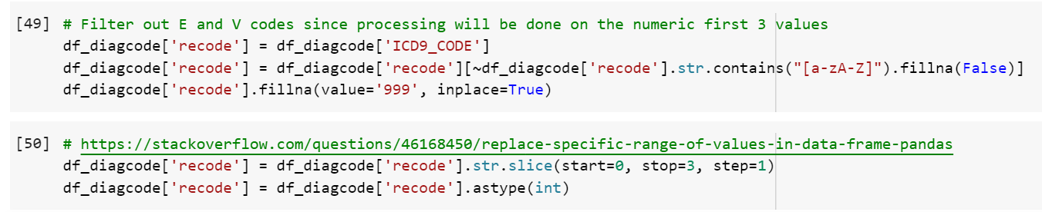
Group ICD9 codes

Slide 29
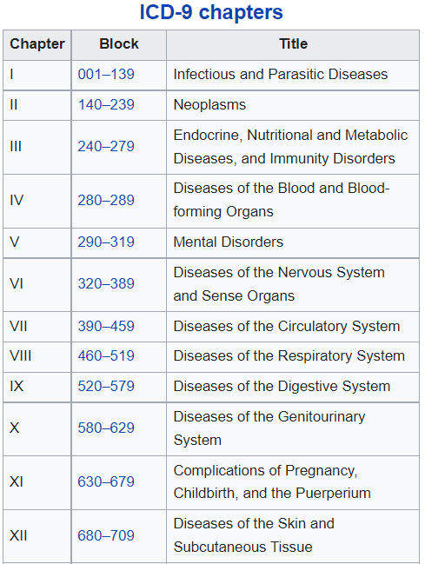
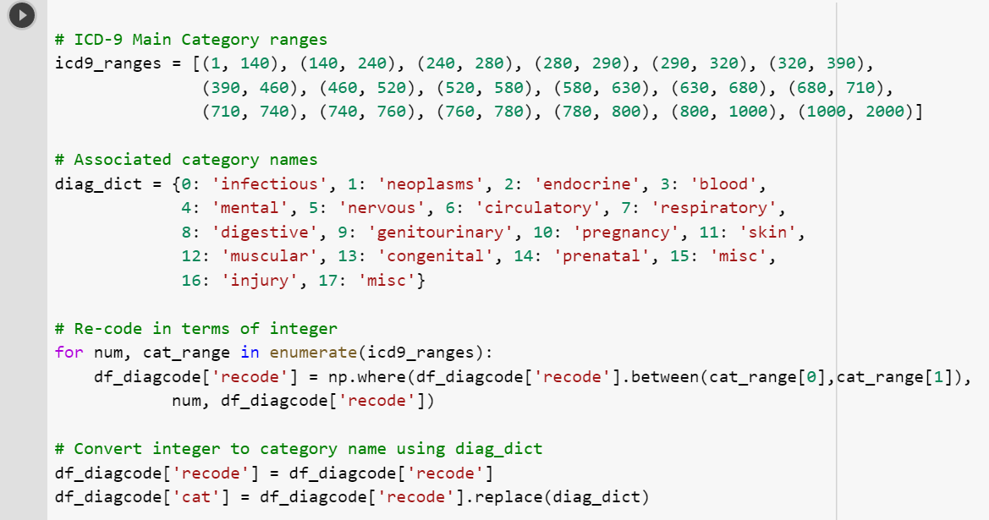
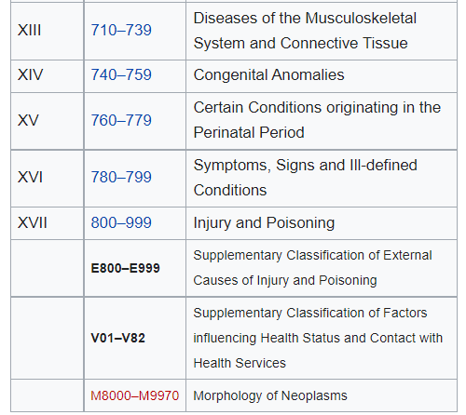
Group ICD9 codes

Slide 30
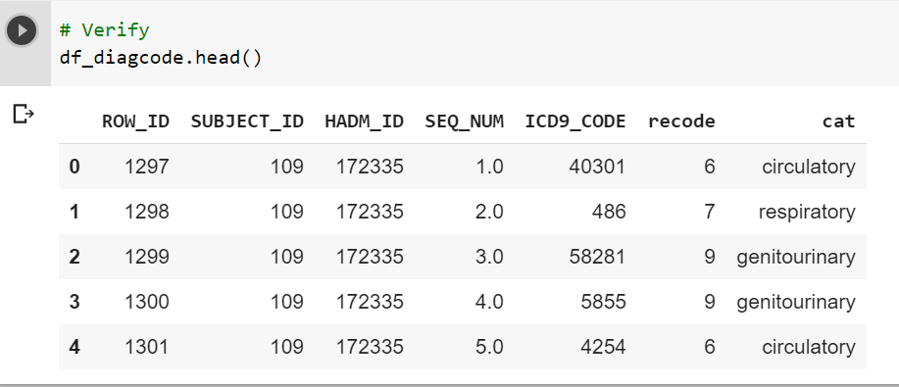
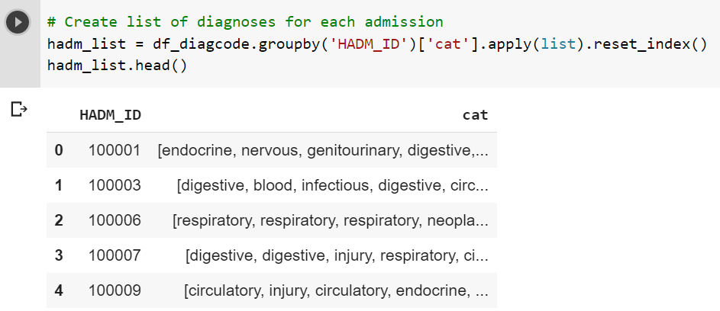
For each admission, there could be (and usually is) more than one diagnosis. Often, there are more than 1 diagnoses for 1 category. Therefore, I need to create a dummy matrix that highlights all the diagnoses for each admission. This should not be done on the SUBJECT_ID since each patient could have different diagnoses for each admission.

Slide 31
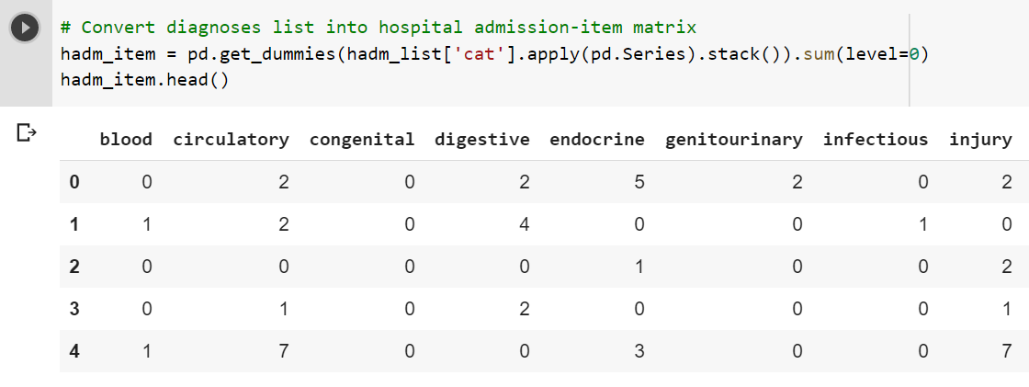
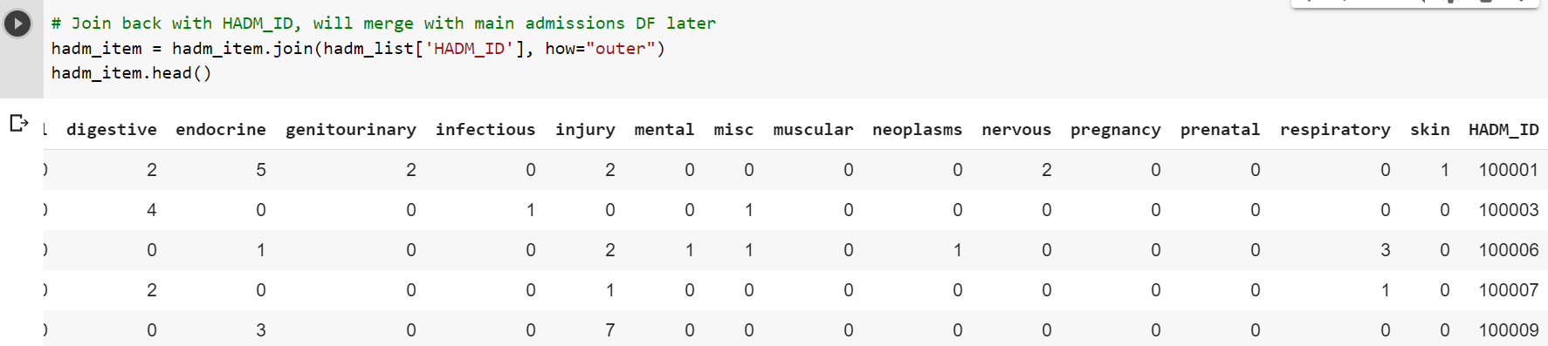

Slide 32
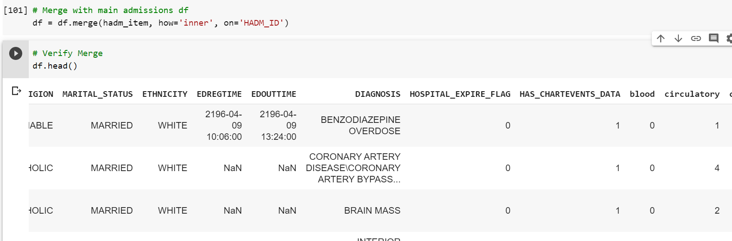
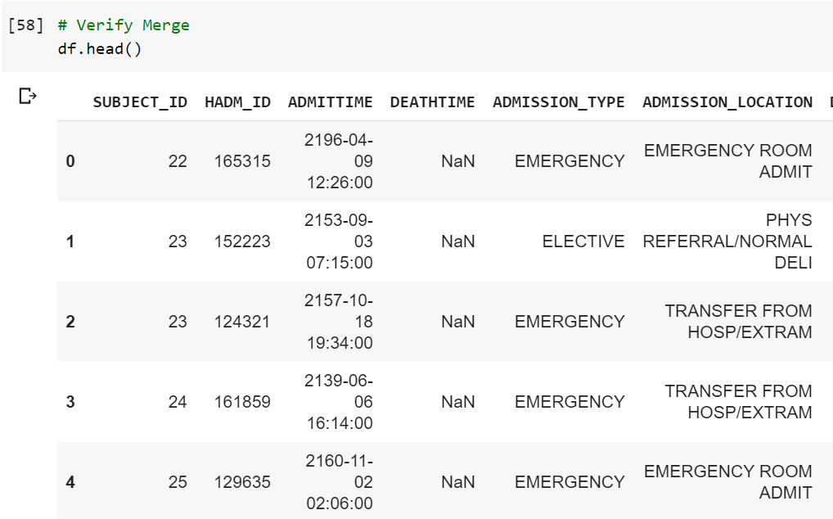

Slide 33
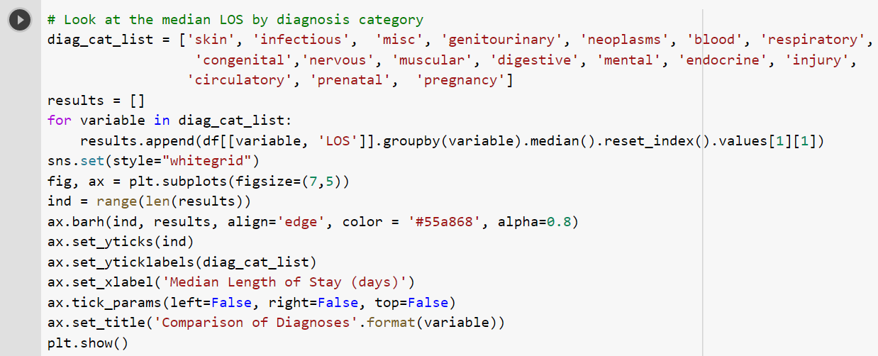


Slide 34
Patients.csv Exploration
The PATIENTS table provides age and gender information. To protect identity, a patient’s age is given by the difference between their 'DOB' date of birth and the date of their first admission. Therefore, subsequent admissions for the same patient need to be ignored in the calculation. The only things that need to be done with this table are to extract the DOB and gender information and merge them with the admissions dataframe.

Slide 35





Slide 36


age

Slide 37




Slide 38


Slide 39

Gender

Slide 40



ICUSTAYS.csv Exploration

Slide 41




Slide 42



Slide 43
Data Preprocessing
Even after completing the feature engineering for age and ICD-9, there were some loose ends that needed tidying up before the data could be used for the prediction model. First, I ensured that no admissions resulting in death were part the cleaned dataset. I dropped all unused columns and verified that no NaNs existed in the data. For the admission type, insurance type, religion, ethnicity, age, and marital status columns, I performed the Pandas get_dummies command to convert these categorical variables into dummy/indicator variables. The final DataFrame size resulted in 48 feature columns and 1 target column with an entry count of 53,104.

Slide 44



Slide 45



Slide 46

Data-clean function
Put all the above into one data clean function

Slide 47

Length-of-Stay Prediction Model
To implement the prediction model, I split the LOS target variable and features into training and test sets at an 80:20 ratio using the scikit-learn train_test_split function. Using the training set, I'll fit five different regression models (from the scikit-learn library) using default settings to see what the R2 score comparison looked like.

Slide 48




Slide 49




Slide 50

Model: Random Forest
Random Forest is an ensemble learning method for classification, regression
Random Forest is a bagging technology that each tree runs parallel and does not communicate with each other. The final result is the average of predictions from all trees (bagging)
It is an ensemble solution which aggregates the decision from each tree.
It is a highly accurate classifier

Slide 51


Model: K-Nearest Neighbors (KNN)

Slide 52


Model: Linear Regression

Slide 53


Model: Gradient Boosting Classifier

Slide 54


Model: Stochastic Gradient Descent

Slide 55



Slide 56
Model Refinement
The GradientBoostingRegressor performed well versus the other regression model. To refine the GradientBoostingRegressor model, I used the GridSearchCV function from scikit-learn to test out various permutations of parameters such as n_estimators, max_depth, and loss. The best estimator result from GridSearchCV was n_estimators=200, max_depth=4, and loss=ls.

Slide 57


Least Absolute Deviations (LAD)
Least Squares (LS)

Slide 58



Slide 59

Evaluation
Feature Importance
In fact, in the top 20 top features, only emergency admission type, gender, and Medicaid insurance showed any importance outside of diagnoses groups.

Slide 60



Slide 61

Evaluation

Slide 62


Evaluation
Lower values of RMSE indicate better fit
The RMSE is the square root of the variance of the residuals. It indicates the absolute fit of the model to the data–how close the observed data points are to the model’s predicted values.
RMSE is a good measure of how accurately the model predicts the response, and it is the most important criterion for fit if the main purpose of the model is prediction
a lower RMSD is better than a higher one

Slide 63



